Slide 1
Workshop 1 Morning session
Data and Data Structures

Slide 2
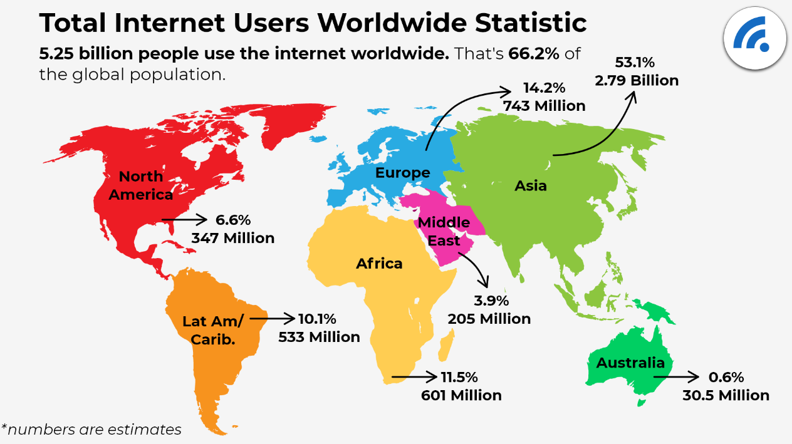
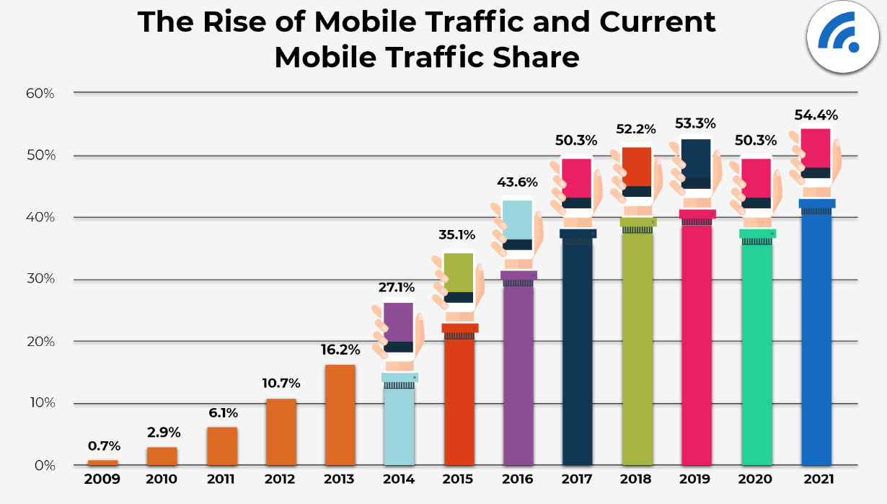
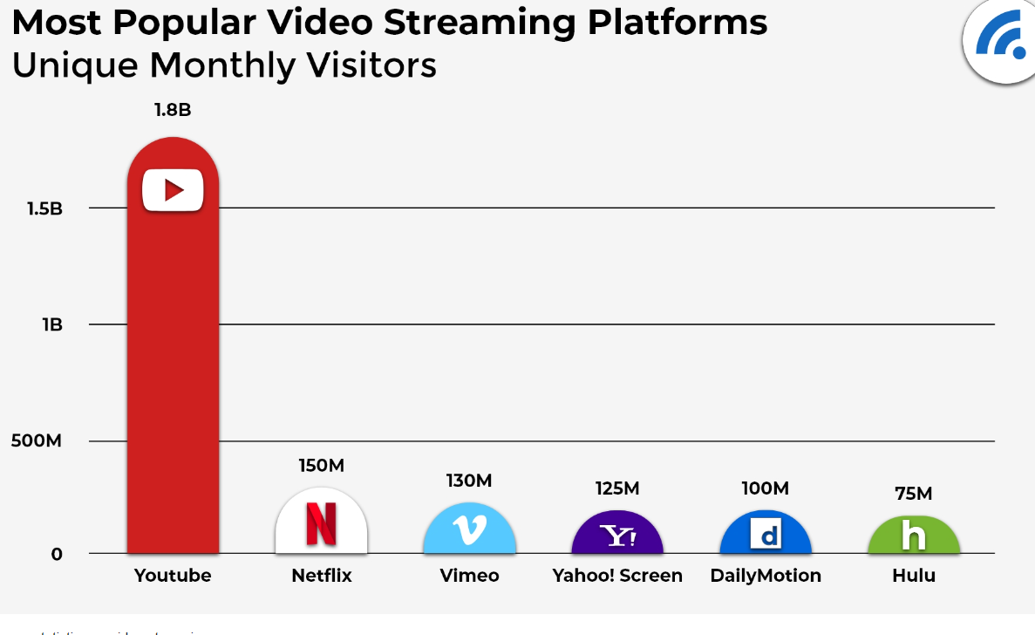
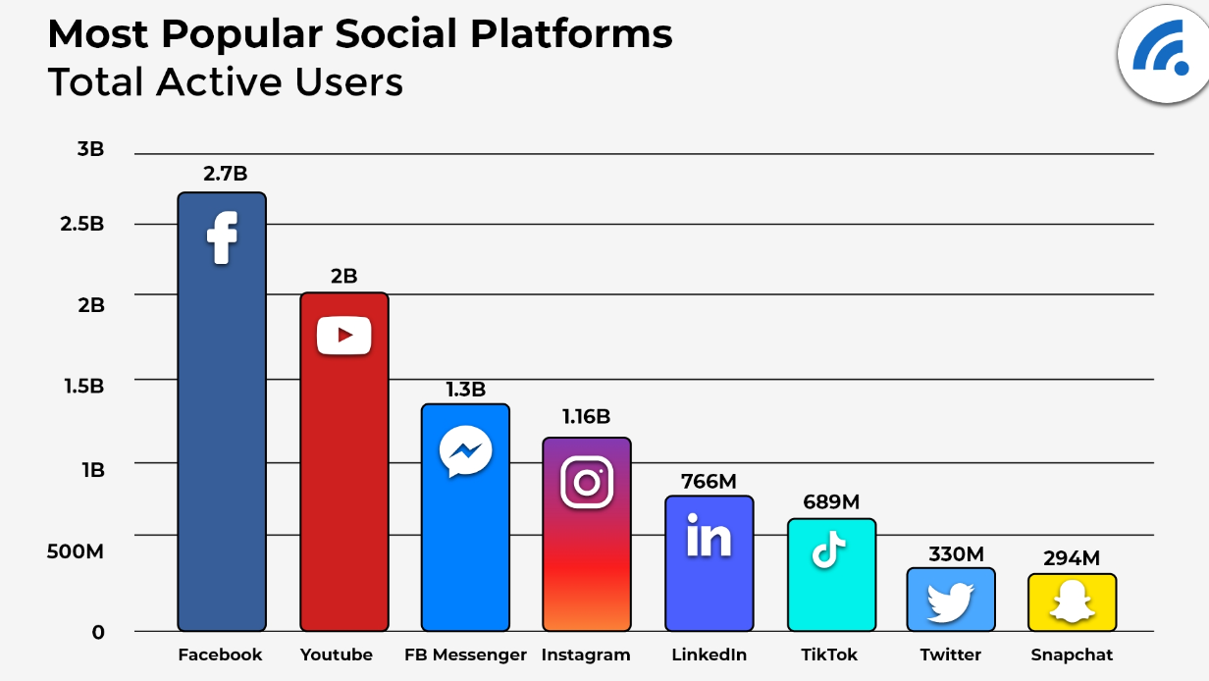
Data is Growing Exponentially
Notes:
Our current love affair with social media certainly fuels data creation. As we know data Never Sleeps. And did you know that Data has become the fasted growing commodity in the world today.
Go through the stats figures with the group.
Explain exponentially by giving example: if you step exponentially (double each time) you will be on the Moon after 30 steps. You can also discuss the idea: https://www.peterfisk.com/2016/04/demonstrating-exponential-growth-by-folding-a-sheet-of-paper-in-half-to-the-moon-and-beyond/

Slide 3
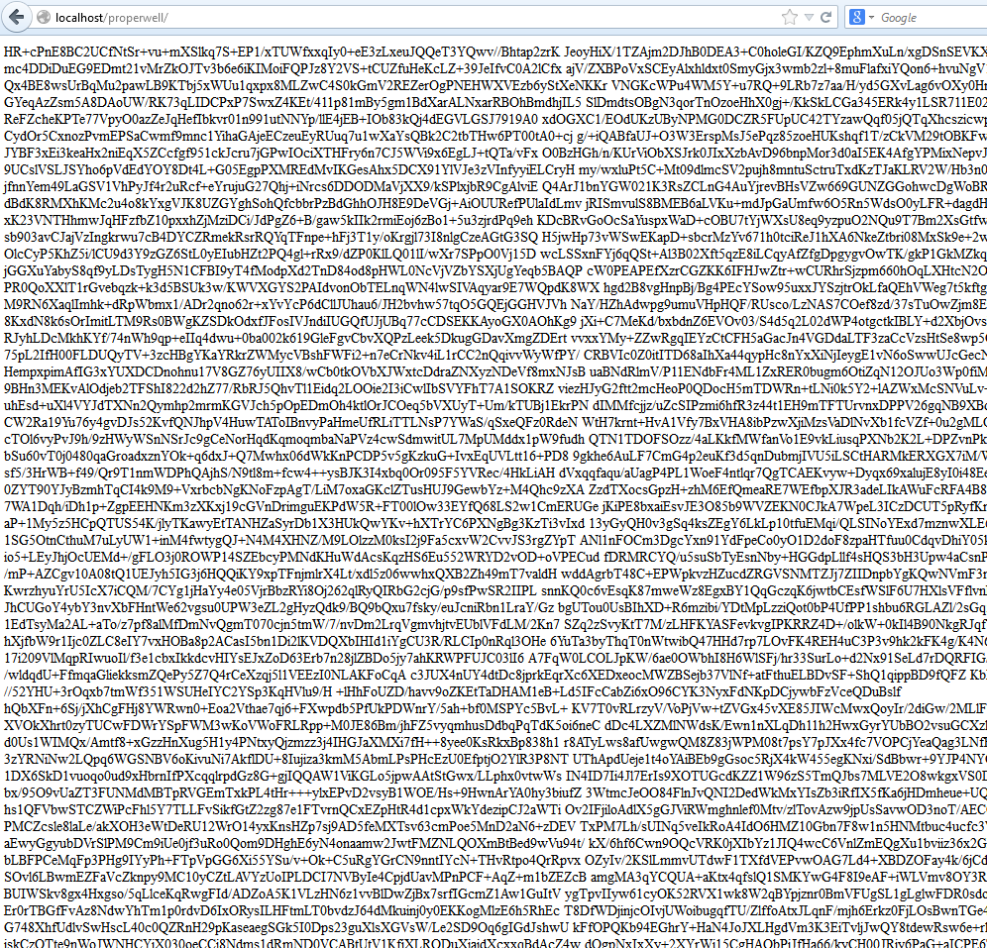
Raw data
https://stackoverflow.com/questions/23195511/application-built-on-joomla-displaying-raw-data-on-localhost

Slide 4
Data Types- Broad categorization
DATA
Numbers
Text
Audio
Images
Video
Notes:
Data today come in different forms including numbers, text, audio, images, and video .
People need to be able to process many different types of data:
An engineering program uses a computer mainly to process numbers: to do arithmetic, to solve geometric equations, to find the roots of a differential equation, and so on.
A word processing program, on the other hand, uses a computer mainly to process text: justify, move, delete, and so on.
A computer also handles audio data. We can play music on a computer and can record sound as data.
An image processing program uses a computer to manipulate images: create, shrink, expand, rotate, and so on.
Finally, a computer can be used not only to show movies, but also to create the special effects seen in movies.
Numerical
Booleans and characters
Primitive types in memory

Slide 5

Signed and Unsigned Numbers
Signed
Positive and Negative Values
Signed data types are the ones that can hold both positive and negative values…
Unsigned
Only positive values
Unsigned data types can hold large positive values, but cannot hold negative values..
Notes:
You can also have signed and unsigned numerical data types. Whether something is signed or unsigned affects the specific range of values that the given data type contains. Everything we've looked at so far is signed, meaning it contains both positive and negative values.
We can also have unsigned data types, where they only contain positive values, and it doubles the positive value range. This means if we had an unsigned short, it could store the values from zero to 65,000 instead of negative 32,000 to positive 32,000

